Slide 1
CUDA Advanced Libraries
cuFFT for Audio/Signal Processing

Slide 2
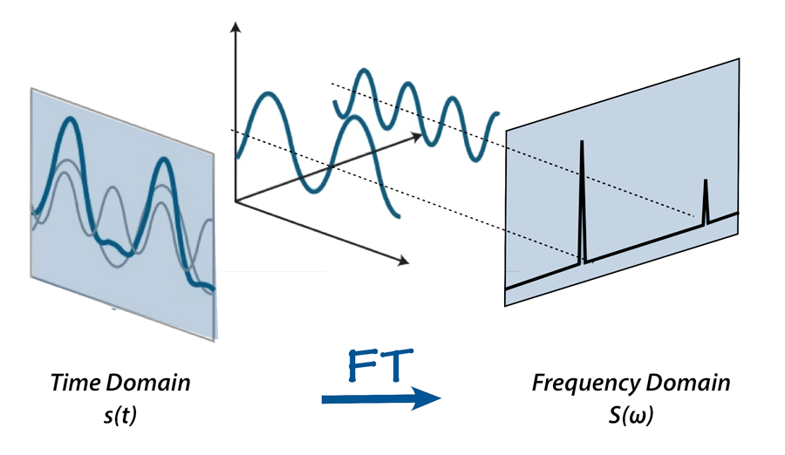
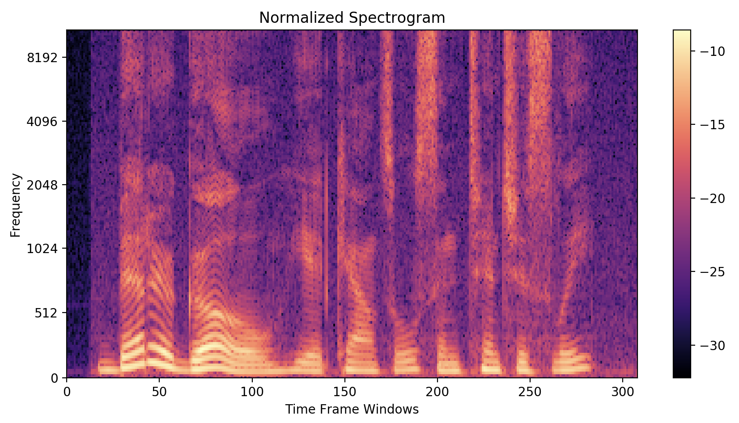
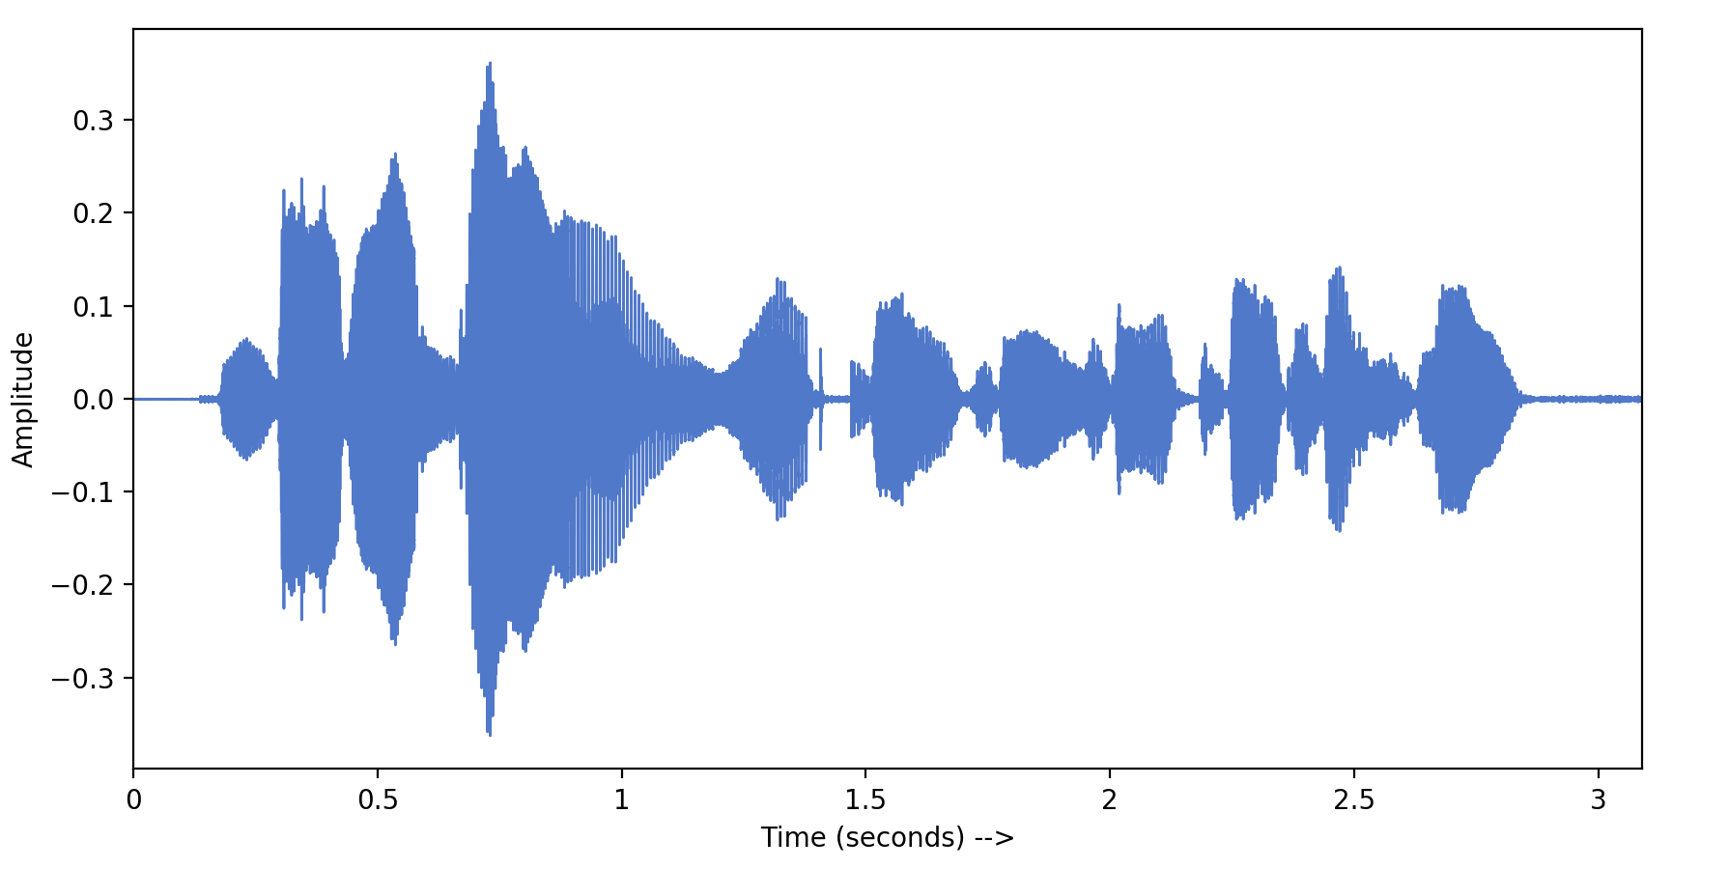
Speech Recognition
Read audio recording into program – this is time domain data
Instead of typical audio amplitude over time, represent audio as spectrogram
Break down into smaller time frames
Transform data into the frequency domain, by applying an FFT
The data can now be treated as an image recognition problem, compare to known FFT’d audio for words
X
[1]

Slide 3
FFT Audio Use Cases
Audio compression – as part of the MP3 codec, removes unwanted signals [2]
FFT Spectral Analyzer
Analyze audio equipment such as amplifiers
Improve audio quality by smoothing signals
Modify signal bands to isolate sounds or to remove background noise

Slide 4
References
[1] 2020. Kartiki Chaudhary. Towards Data Science. Fourier Transform, FFT and Spectrogram features for a Speech Recognition System. Found at https://towardsdatascience.com/understanding-audio-data-fourier-transform-fft-spectrogram-and-speech-recognition-a4072d228520.
[2] 2012. Guckert. The Use of FFT and MDCT in MP3 Audio Compression. Found at https://www.math.utah.edu/~gustafso/s2012/2270/web-projects/Guckert-audio-compression-svd-mdct-MP3.pdf

